Slide 1

Mini Project Report
WORLD LARGEST UNIVERSITY WEBSITE

Slide 2

AJAY KUMAR GARG ENGINEERING COLLEGE
Submitted To
Summited By
RANJEET YADAV 2000270130135
MR. SARVACHAN VERMA
SHIVAM SHARMA 2000270130162

Slide 3
Dr A.P.J Abdul Kalam Technical University utter Pradesh Lucknow
ACKNOWLEDGEMENT
We express our deep sense of gratitude to our RESPECTED HOD-> DR. ANU CHAUDHARY college name for the valuable guidance and for permitting us to carry out this project.
We express our deep sense of gratitude to our guide Mr. SERVACHAN VERMA, Assistant professor, Department of IT, college name->AJAY KUMAR GARG ENGINEERING COLLEGE, for the valuable guidance and suggestions.
I consider myself lucky enough to get such a good project. This project would add as an asset to my academic profile.
We express our thanks to all those who contributed for the successful completion of our project work.
With gratitude
Name (Roll no) -> SHIVAM SHARMA 2000270130162
Name(Roll no)-> RANJEET YADAV 2000270130135

Slide 4
TABLE OF CONTENT
CONTENT
PAGE NO.
Abstract
Introduction
Objective
Concept used
Codes
Findings & Result
Problem statement
Conclusion
References
1
2
3
4-7
8-19
20-29
30
31
32

Slide 5
ABSRACT
This website is a HTML ,CSS and little bit of java script and php based website it is provide the accurate and correct data for the students.
This website is also provide different type of courses that like under graduation ,post graduation, and intermediate also ,and very useful for the students.
1

Slide 6
INTRODUCTION
This is the world largest university website that is provided different type of courses at the level of inter UG,PG and different department like Business analytics , Data science ,computer science, journalism commerce.
This is also provide a world class library , best canteens for breakfast and having a largest playground.
It is famous all over the world like London, New York , Washington for their best infrastructures and best quality education.
2

Slide 7
OBJECTIVE
To provide best performance of the university facilities so that student can utilizes the facilities of the university and do their best performance all over the world.
The student who is not able to coming offline in the campus they can get benefit throw this website.
The student who is from outside of nation they would also get benefit and utilizes the facility of provided by university.
3

Slide 8
Concept Used
HTML
HTML is short for Hypertext Markup Language. HTML is used to create electronic documents (called pages) that are displayed on the World Wide Web. Each page contains a series of connections to other pages called hyperlinks. Every web page you see was written using one version of HTML.
HTML code ensures the proper formatting of text and images for your Internet browser. Without HTML, a browser would not know how to display text as elements or load images or other elements. HTML also provides a basic structure of the page, upon which Cascading Style Sheets are overlaid to change its appearance.
4

Slide 9
Concept used
CSS ,Stands for "Cascading Style Sheet." Cascading style sheets are used to format the layout of Web pages. They can be used to define text styles, table sizes, and other aspects of Web pages that previously could only be defined in a page's HTML.
CSS
CSS helps Web developers create a uniform look across several pages of a Web site. Instead of defining the style of each table and each block of text within a page's HTML, commonly used styles need to be defined only once in a CSS document. Once the style is defined in cascading style sheet, it can be used by any page that references the CSS file.
5

Slide 10
Concept used
JAVASCRIPT
JavaScript is a lightweight, cross-platform, and interpreted scripting language. It is well-known for the development of web pages, many non-browser environments also use it. JavaScript can be used for Client-side developments as well as Server-side developments. JavaScript contains a standard library of objects, like Array, Date, and Math, and a core set of language elements like operators, control structures, and statements.
Internal JS: We can add JavaScript directly to our HTML file by writing the code inside the <script> tag. The <script> tag can either be placed inside the <head> or the <body> tag according to the requirement.
External JS: We can write JavaScript code in other file having an extension js and then link this file inside the <head> tag of the HTML file in which we want to add this code.
6

Slide 11
CONCEPT USED
PHP
PHP is a recursive acronym for "PHP: Hypertext Preprocessor". PHP is a server side scripting language that is embedded in HTML. It is used to manage dynamic content, databases, session tracking, even build entire e-commerce sites.
It is integrated with a number of popular databases, including MySQL, PostgreSQL, Oracle, Sybase, Informix, and Microsoft SQL Server.
PHP is pleasingly zippy in its execution, especially when compiled as an Apache module on the Unix side. The MySQL server, once started, executes even very complex queries with huge result sets in record-setting time.
7

Slide 12
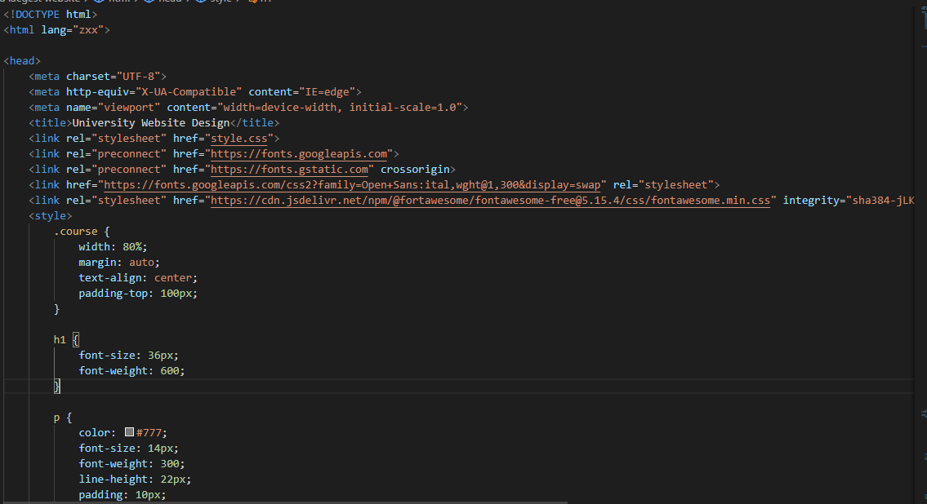
CO
CODES
8

Slide 13
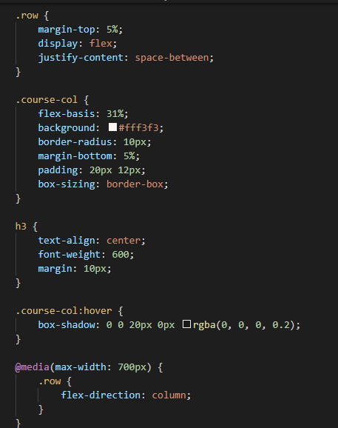
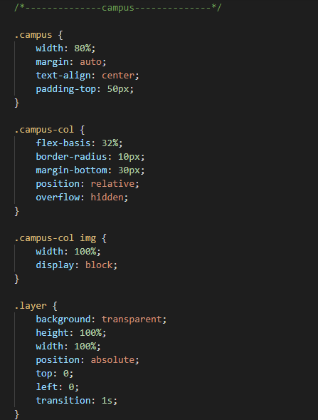
CO
CODES
9

Slide 14
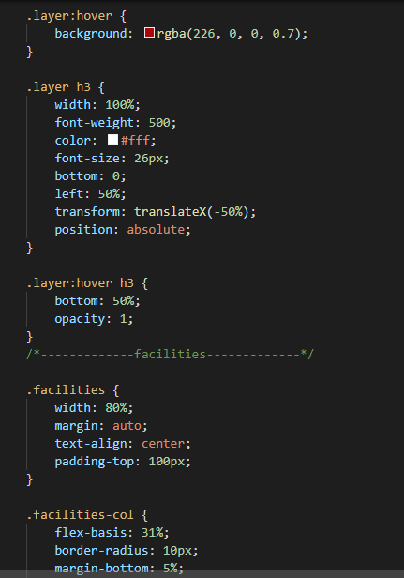
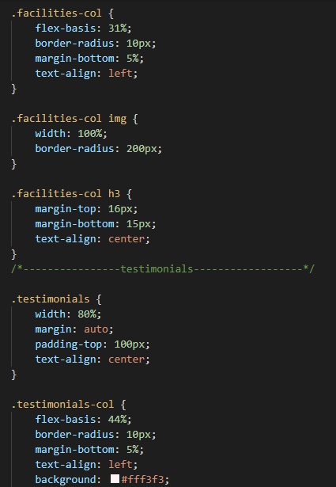
CO
CODES
10

Slide 15
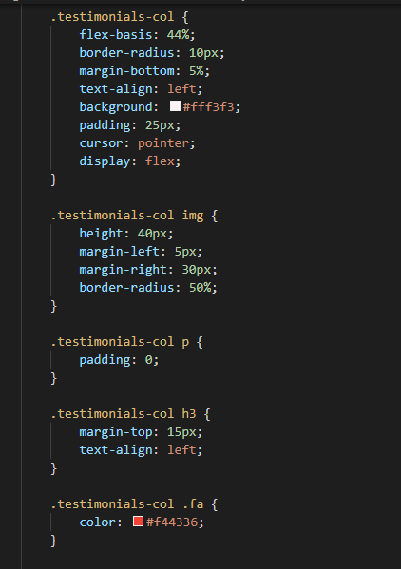
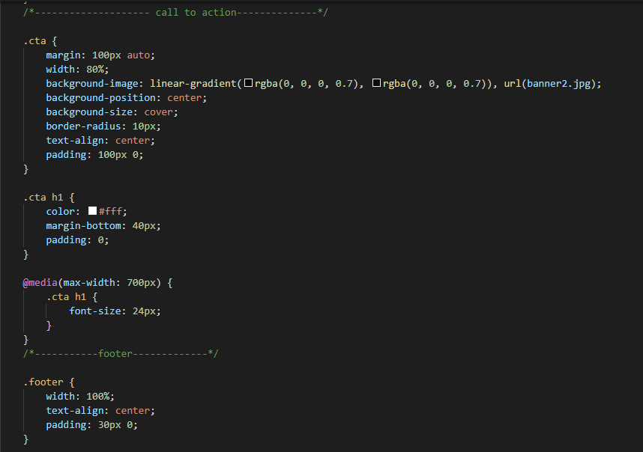
CO
CODES
11

Slide 16
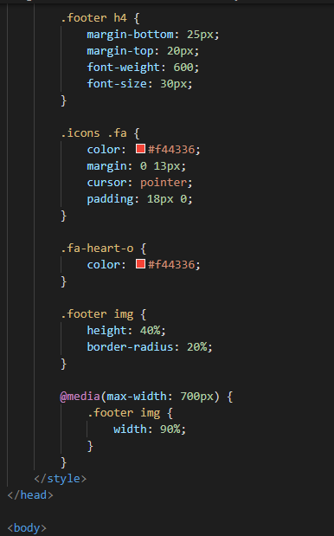
CO
CODES
12

Slide 17
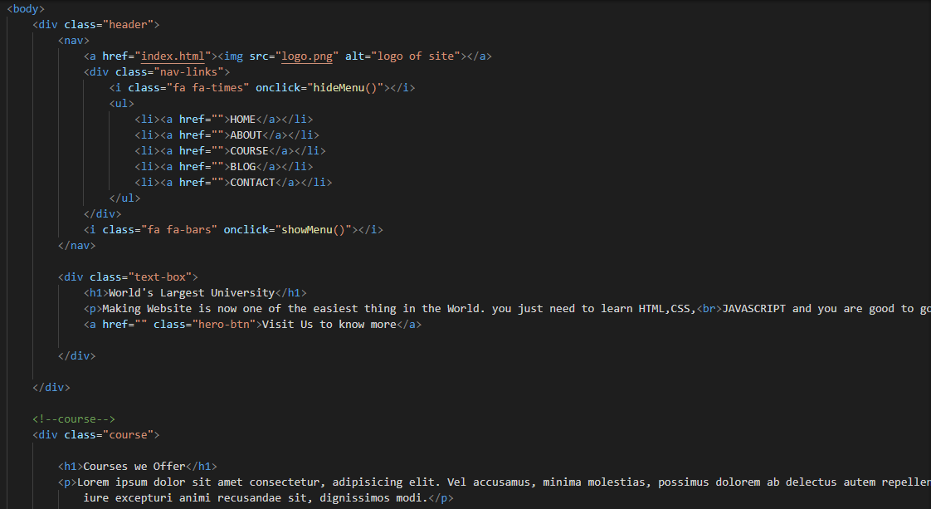
CO
CODES
13

Slide 18
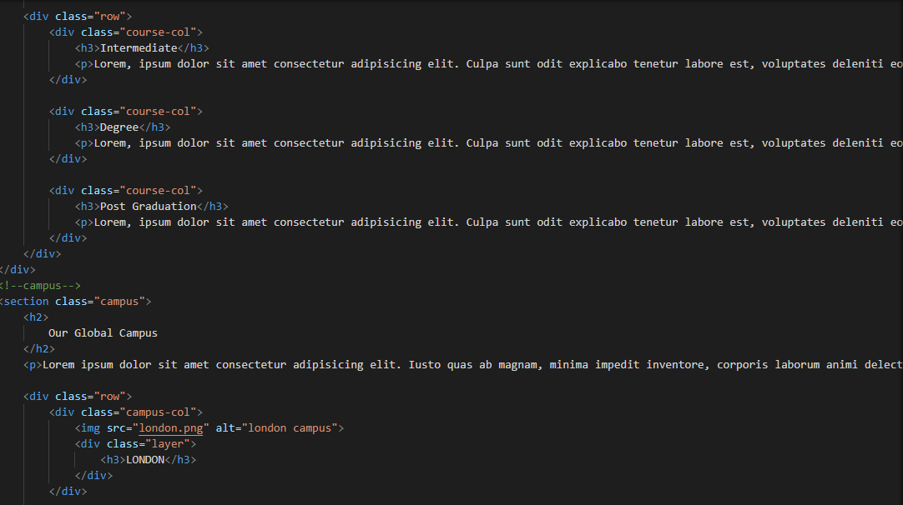
CO
CODES
14

Slide 19
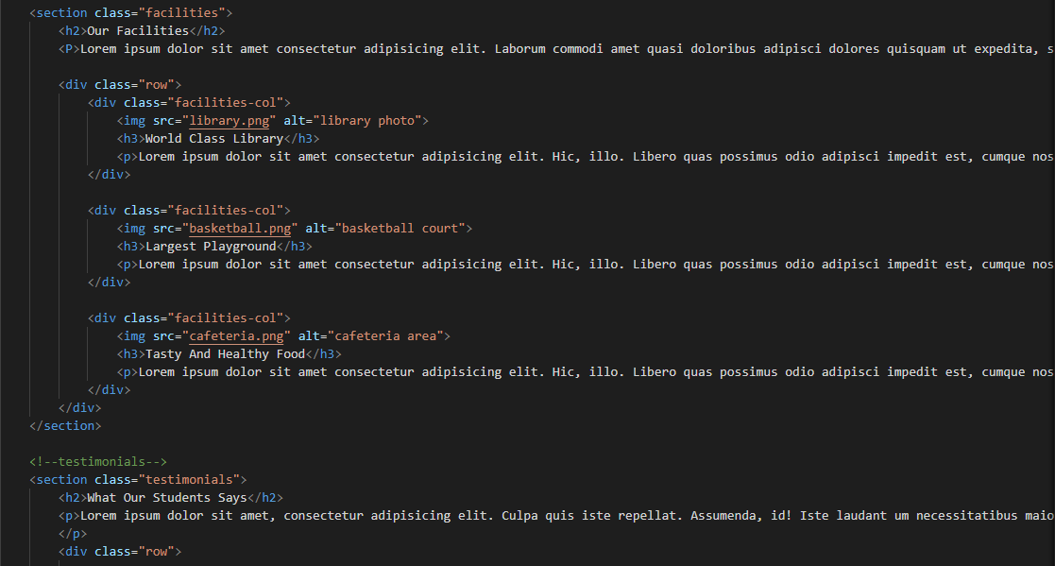
CO
CODES
15

Slide 20
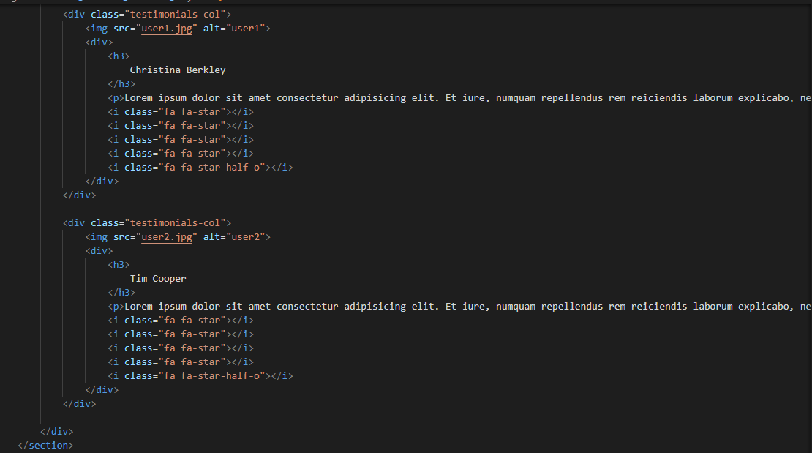
CO
CODES
16

Slide 21
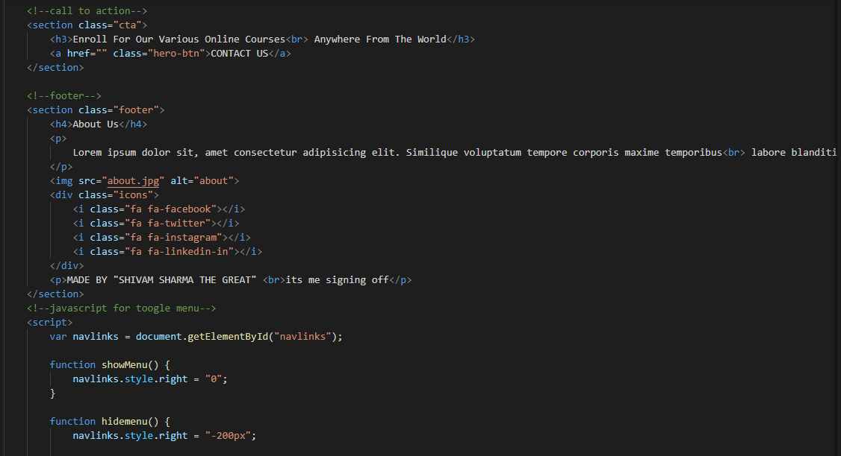
CO
CODES
17

Slide 22
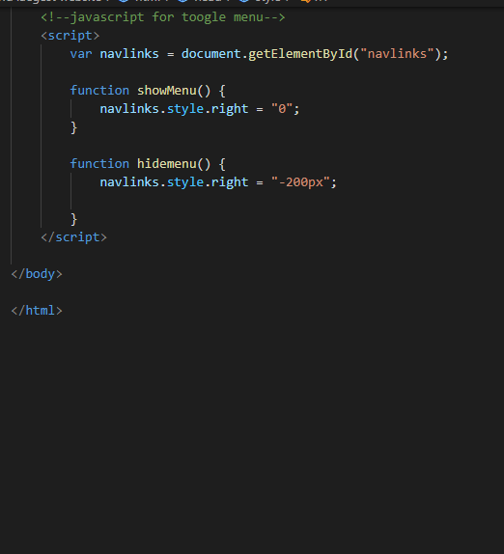
CO
CODES
18

Slide 23
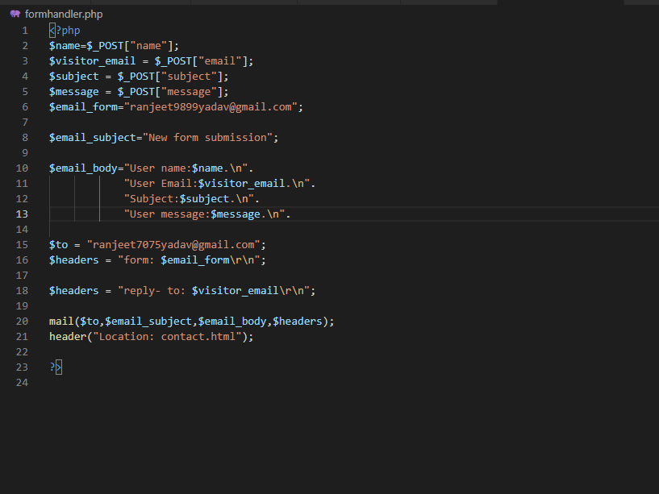
cfo
CODE
19

Slide 24

FINDING AND RESULT
20

Slide 25

FINDING AND RESULT
21

Slide 26

FINDING AND RESULT
22

Slide 27
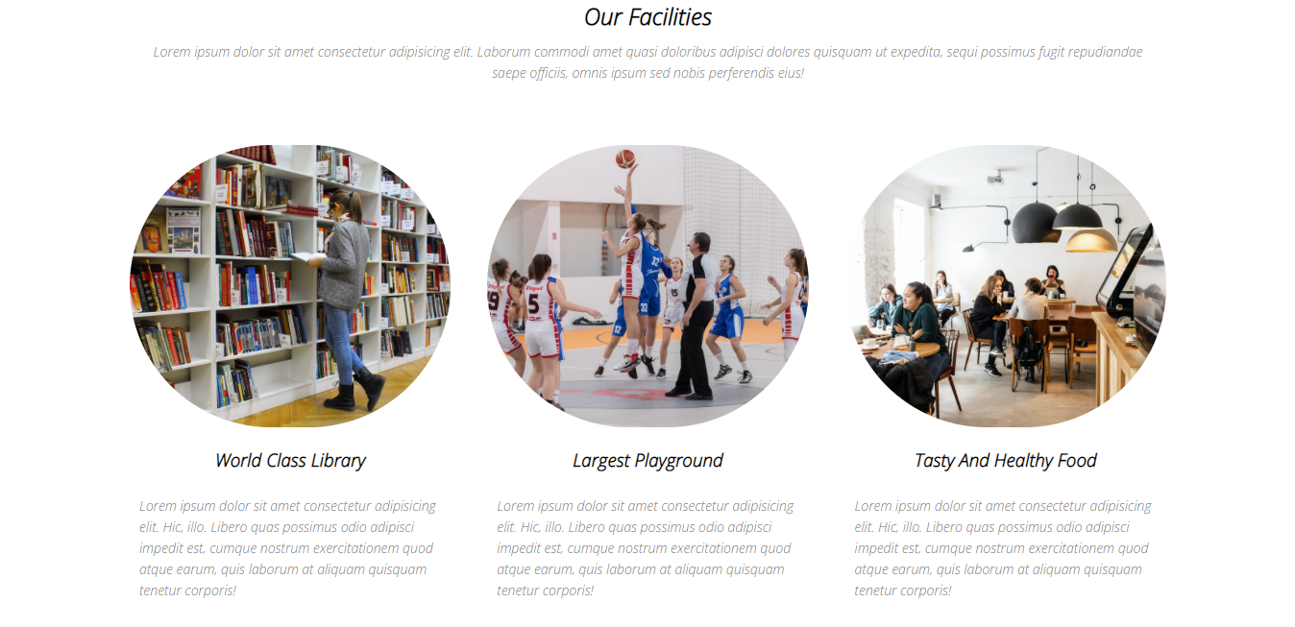
FINDING AND RESULT
23

Slide 28

FINDING AND RESULT
24

Slide 29
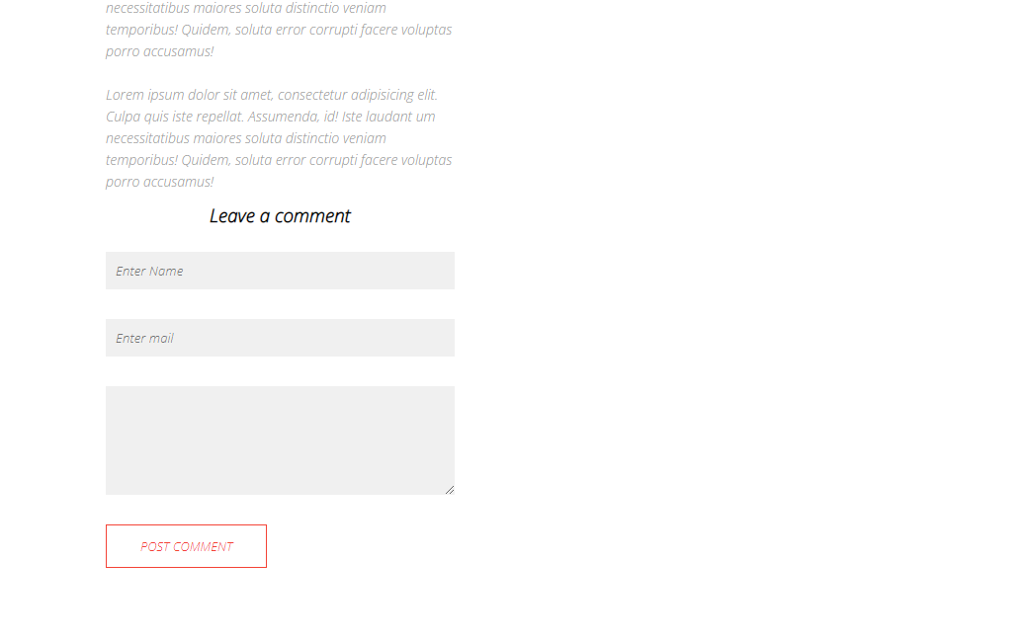
FINDING AND RESULT
25

Slide 30
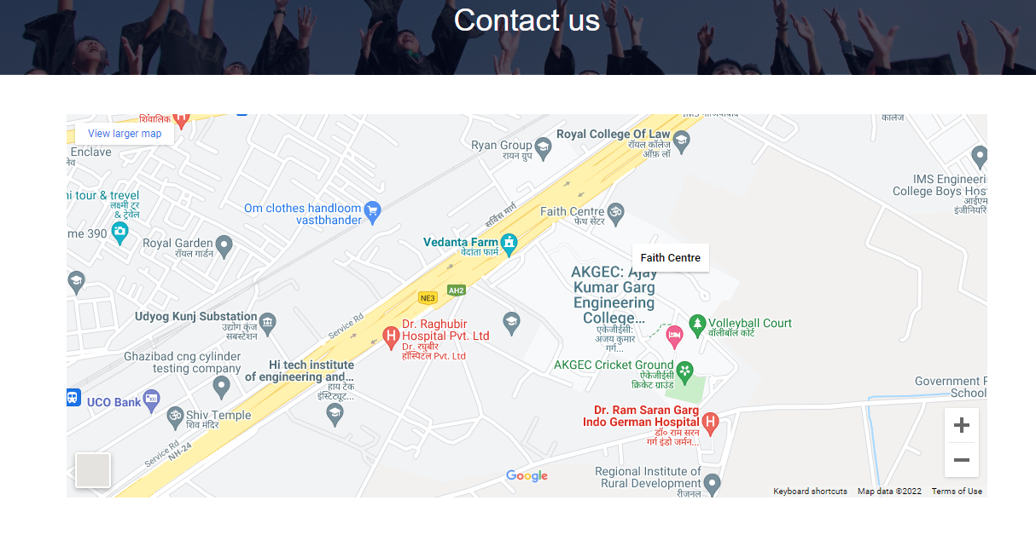
FINDING AND RESULT
26

Slide 31
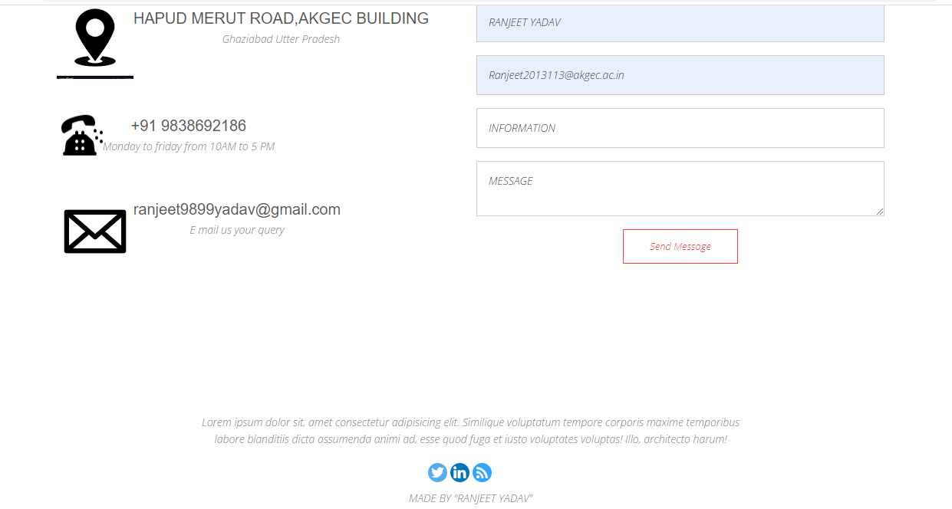
FINDING AND RESULT
27

Slide 32
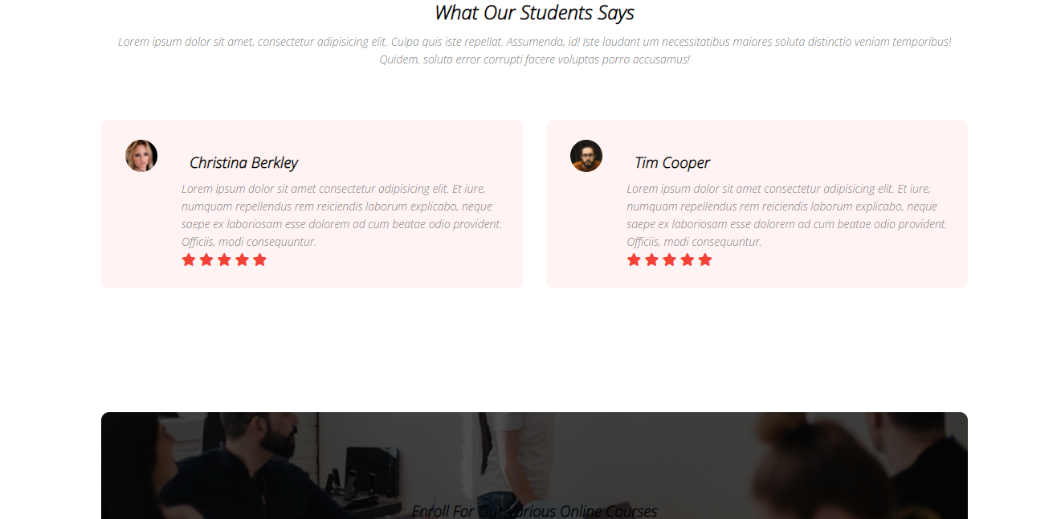
FINDING AND RESULT
28

Slide 33

FINDING AND RESULT
29

Slide 34
PROBLEM STATEMENT
30
There is a problem to hosting the website , since we have not purchase any plan for hosting the website , so if anyone want to use the website for their personal purpose or work.
They will purchase the plan and use this website. It is 100% working and responsible website.

Slide 35
CONCLUSION
31
This is achieved to student can get and utilize the facility provided by university from any where, and do their best for their future.
Anyone can easily access this website free of coast.

Slide 36
REFERANCES
32
YOU TUBE
GOOGLE
BOOKS
W3SCHOOL
FONT AWESOME
ICON8.COM

Slide 37
THANKU YOU

